Slide 1
Chapter 8
Calculus Operations with MATLAB
We are now ready to see how calculus operations can be performed with MATLAB. It should be noted that a digital computer operates on a numerical basis with addition, subtraction, multiplication, and division, along with memory storage and logic. True differentiation and integration can never be achieved exactly with numerical processes. However, there are two ways that differentiation and integration can be achieved on a practical level with MATLAB.

Slide 2
Two Types of Operations
First, MATLAB can be viewed as a very comprehensive "look-up" table in that numerous derivatives and integrals as character strings can be manipulated with software. The Symbolic Math Toolbox permits the exact formulas for derivatives and integrals to be extracted, manipulated, and plotted.

Slide 3
Two Types of Operations
(Continued)
Second, MATLAB can be used for calculus with numerical approximations to differentiation and integration. While such approximations are not exact, they can be used to provide extremely close approximations to the derivatives and integrals of experimental data, even when closed form solutions are impossible.

Slide 4
Symbolic Variables
A symbolic variable is one that can be manipulated in the same manner as in an equation, and it may or may not ever take on any numerical values. To make x and a symbolic, the command is
>> syms x a
Alternately, the symbolic portion of a command may be enclosed with apostrophes ' '.

Slide 5
Symbolic Differentiation
The command is diff( ) with the function to be differentiated in parentheses. All variables should have been established as symbolic variables or the function should be enclosed by apostrophes.

Slide 6
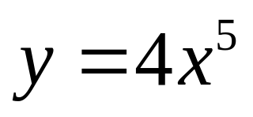
Example 8-1. Use MATLAB to determine derivative of function below.
>> syms x
>> y = 4*x^5
y =
4*x^5
>> yprime = diff(y)
yprime =
20*x^4

Slide 7
Example 8-1. Continuation.
Second Approach:
>> yprime = diff(4*x^5)
yprime =
20*x^4

Slide 8
Example 8-1. Continuation.
Third Approach:
>> y = '4*x^5'
y =
4*x^5
>> yprime = diff(y)
yprime =
20*x^4

Slide 9
Example 8-1. Continuation.
The third approach could also be performed in one step.
>> yprime = diff('4*x^5')
yprime =
20*x^4

Slide 10
Example 8-2. Use ezplot to plot y and yprime of Example 8-1.
The simplest form is ezplot(y), but the domain will be from -2π to 2π. The domain can be changed by
>> ezplot(y, [x1 x2])
In this example,
ezplot(y, [-1 1])
ezplot(yprime,[-1 1])
The plots after labeling are shown on the next two slides.

Slide 11
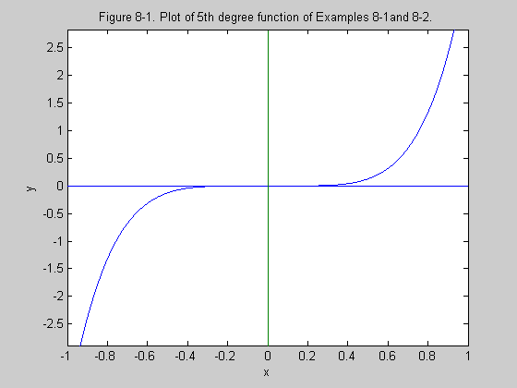

Slide 12
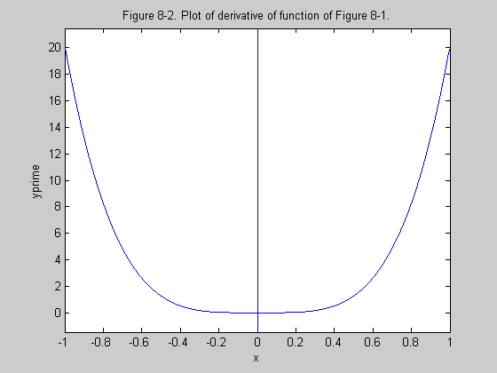

Slide 13
Symbolic Integration
The command is int( ) with the function to be integrated in parentheses. All variables should have been established as symbolic variables or the function should be enclosed by apostrophes.
Indefinite Integral:
>> yint = int(y)
Definite Integral:
>> yint = int(y, a, b)

Slide 14
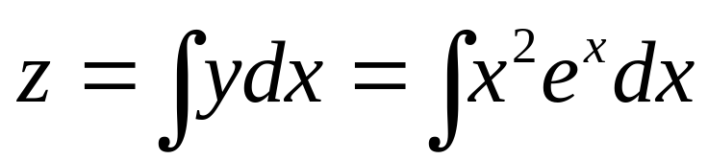
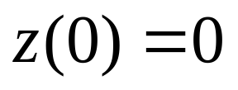
Example 8-3. Use MATLAB to determine integral of function below.
>> syms x
>> y = x^2*exp(x)
y =
x^2*exp(x)
>> z = int(y)
z =
x^2*exp(x)-2*x*exp(x)+2*exp(x)

Slide 15
Example 8-3. Continuation.
We require that z(0) = 0, but the function obtained has a value of 2 at x = 0. Thus,
>> z = z - 2
z =
x^2*exp(x)-2*x*exp(x)+2*exp(x)-2
Plots of y and z are shown on the next two slides.

Slide 16
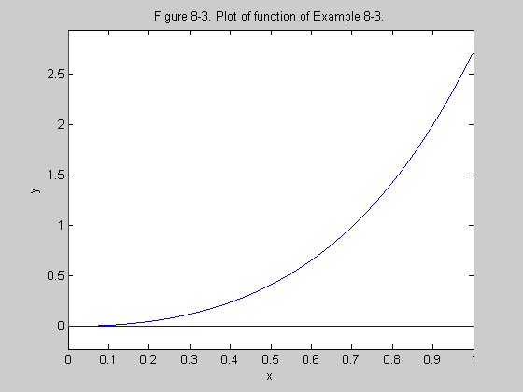

Slide 17
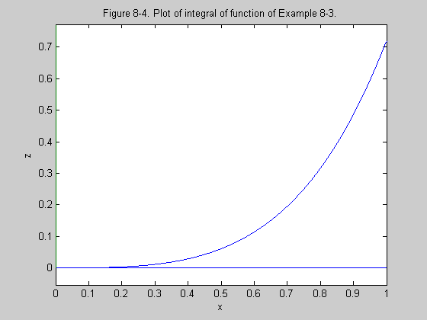

Slide 18
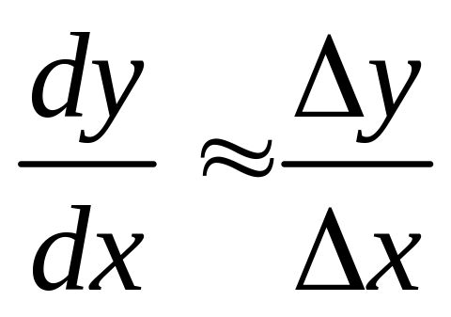
Numerical Differentiation
Generally, numerical differentiation is more prone to error than numerical integration due to the nature of “sudden changes” in differentiation.

Slide 19
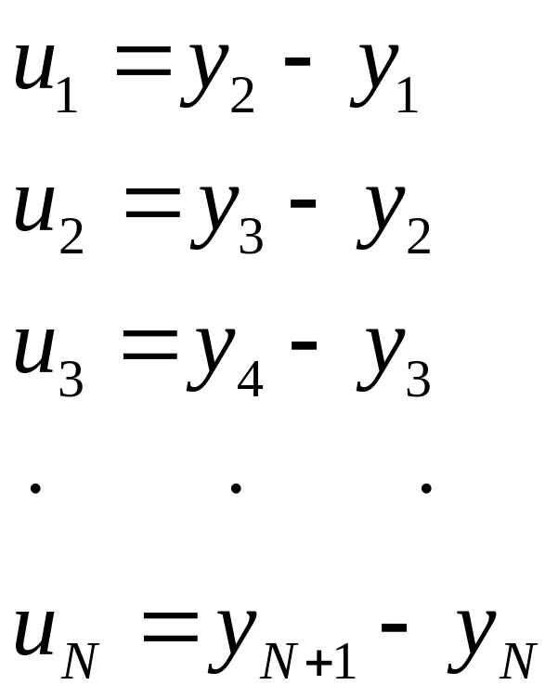
Diff Command for Numerical Data
Assume that x and y have been defined at N+1 points. A vector u with N points is defined as

Slide 20
Diff Command for Numerical Data. Continuation.
The following command forms u:
>> u = diff(y)
To approximate derivative,
>> yprime = diff(y)/delx
Because x and y have one more point than yprime, they can be adjusted.
>> x = x(1:N)
>> y = y(1:N)
>> plot(x, y, x, yprime)

Slide 21
Example 8-5(a) For y = sin x, determine numerical derivative based on 11 points in one cycle.
>> x = linspace(0, 2*pi, 11);
>> y = sin(x);
>> delx = 2*pi/10;
>> yprime = diff(y)/delx;
>> x = x(1:10);
>> plot(x, yprime, x, cos(x),’o’)
The plots are shown on the next slide.The approximation is “crude” as expected.

Slide 22
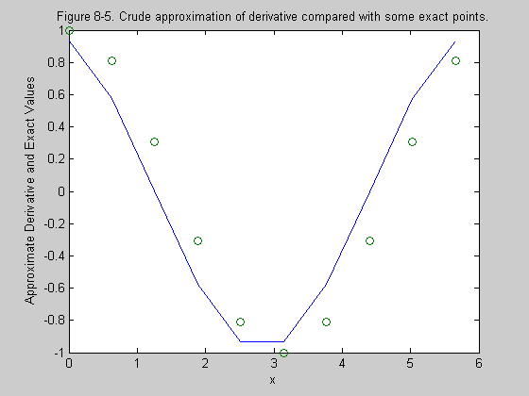

Slide 23
Example 8-5(b) For y = sin x, determine numerical derivative based on 101 points in one cycle.
>> x = linspace(0, 2*pi, 101);
>> y = sin(x);
>> delx = 2*pi/100;
>> yprime = diff(y)/delx;
>> x = x(1:100);
>> plot(x, yprime, x, cos(x),’o’)
The plots are shown on the next slide.The approximation is much better.

Slide 24
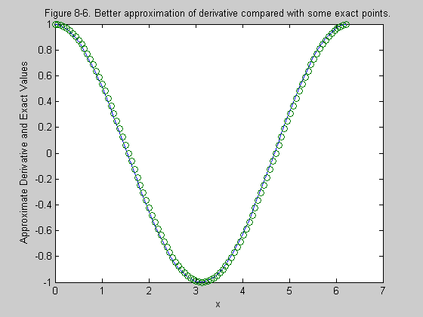

Slide 25
Numerical Integration
Two types will be studied:
1. Zero-order integration
2. First-order integration, which is also known as the trapezoidal rule.
Assume vectors x and y that have each been defined at N points.

Slide 26
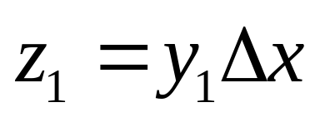
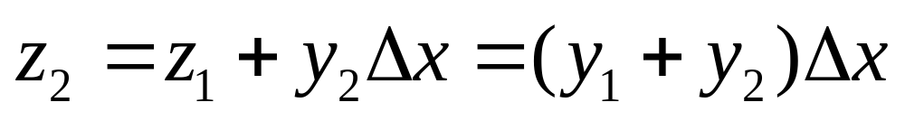
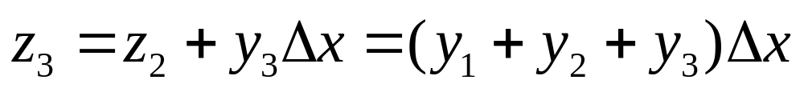
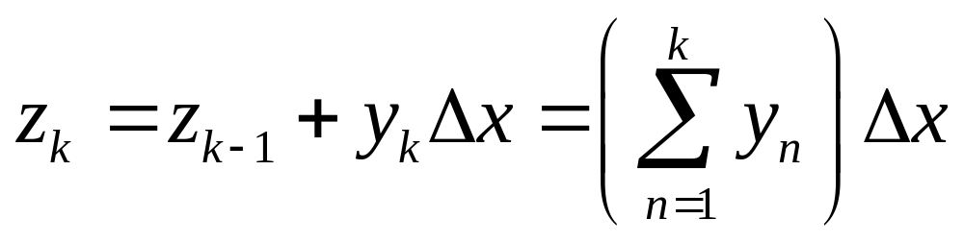
Zero-Order Integration

Slide 27
Two Zero-Order MATLAB Commands
The two MATLAB commands for zero-order integration are sum() and cumsum().
>> area = delx*sum(y)
>> z = delx*cumsum(y)

Slide 28
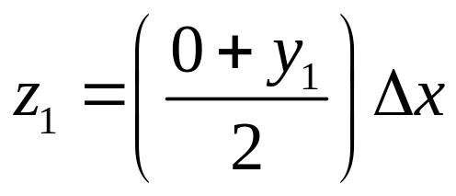
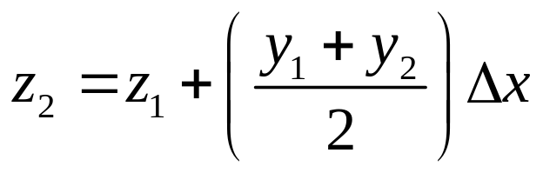
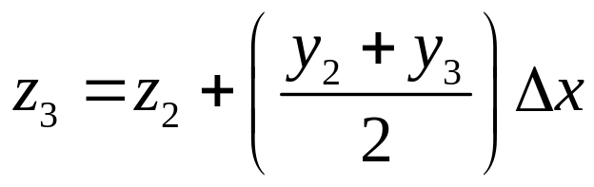
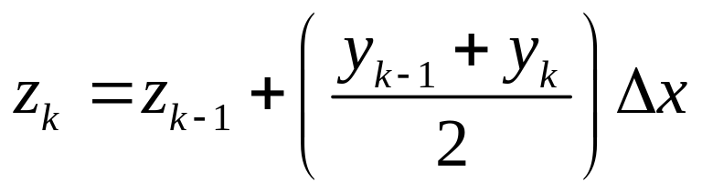
First-Order Integration

Slide 29
Two First-Order MATLAB Commands
The two MATLAB commands for first-order integration are trapz() and cumtrapz().
>> area = delx*trapz(y)
>> z = delx*cumtrapz(y)

Slide 30
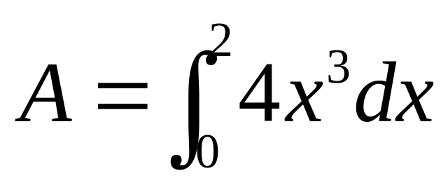
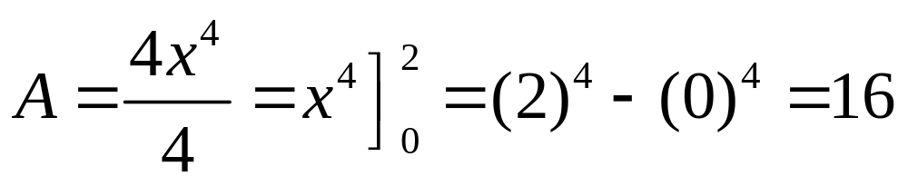
Example 8-6(a). Determine exact area A for following integral:

Slide 31
Example 8-6(b). Determine approximate area A1 with zero-order integration algorithm and step-size of 0.05.
>> delx = 0.05;
>> x = 0:delx:2;
>> y = 4*x.^3;
>> A1 = delx*sum(y)
A1 =
16.8100

Slide 32
Example 8-6(c). Determine approximate area A2 with first-order integration algorithm and step-size of 0.05.
>> delx = 0.05;
>> x = 0:delx:2;
>> y = 4*x.^3;
>> A2 = delx*trapz(y)
A2 =
16.0100

Slide 33
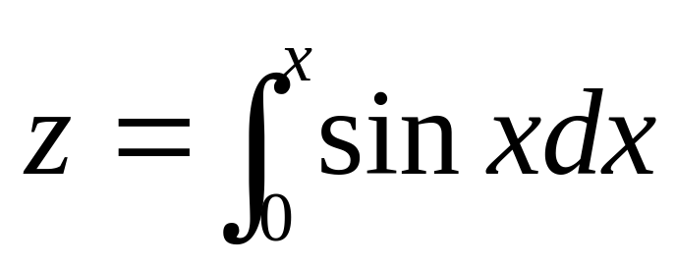
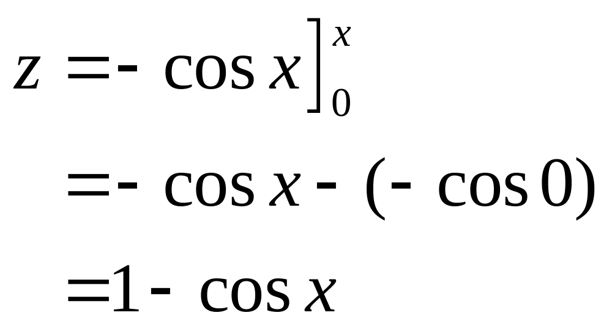
Example 8-7(a). Determine the exact running integral for the following function:

Slide 34
Example 8-7(b) and (c). Determine first-order approximation with 100 points per cycle and plot the two functions.
>> delx = 2*pi/100;
>> x = 0:delx:2*pi;
>> y = sin(x);
>> z1 = delx*cumtrapz(y);
>> plot(x, z1, x, 1 - cos(x), ‘o’)
The plots are shown on the next slide.

Slide 35
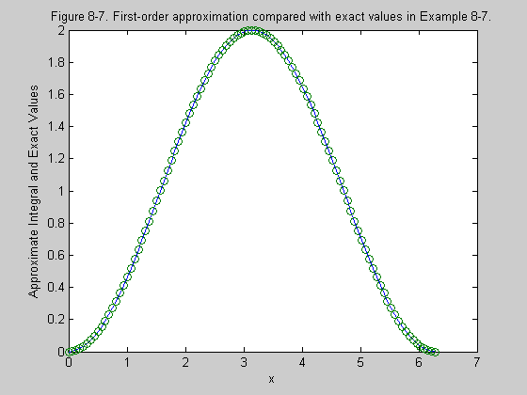

Slide 36
Example 8-8
A test is performed on a mechanical part and the acceleration versus time is measured and shown on the next slide. Use MATLAB to determine and plot the velocity and displacement as a function of time.

Slide 37
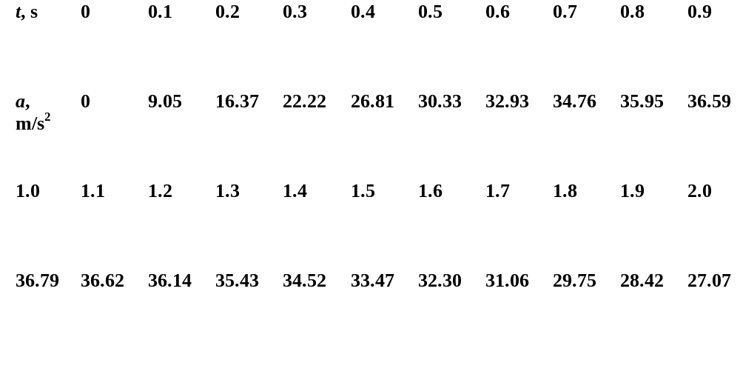
Acceleration versus Time Data

Slide 38
MATLAB Analysis
>> delt = 0.1;
>> t = 0:delt:2;
>> a = [ the 21 values of a];
>> v = delt*cumtrapz(a);
>> y = delt*cumtrapz(v);
>> plot(t,a,t,v,t,y)
Additional labeling was provided and the curves are shown on the next slide.

Slide 39
